Slide 1
Modeling and Simulation
Monté Carlo Simulation

Slide 2
Goals of Today
Understand the concept of Monté Carlo Simulation
Learn how to use Monté Carlo Simulation to make good decisions

Slide 3
What is Monte Carlo Simulation ?
Monte Carlo methods are a widely used class of computational algorithms for simulating the behavior of various physical and mathematical systems, and for other computations.
Monte Carlo algorithm is often a numerical Monte Carlo method used to find solutions to mathematical problems (which may have many variables) that cannot easily be solved, (e.g. integral calculus, or other numerical methods)

Slide 4
What is Monte Carlo Simulation ?
A Monte Carlo simulation is a statistical simulation technique that provides approximate solutions to problems expressed mathematically. It utilizes a sequence of random numbers to perform the simulation.
This technique can be used in different domains:
  complex integral computations,
  economics,
  making decisions in specific complex problems, …

Slide 5
General Algorithm of Monte Carlo Simulation
In general, Monte Carlo Simulation is roughly composed of five steps:
  Set up probability distributions: what is the probability distribution that will be considered in the simulation
  Build cumulative probability distributions
  Generate random numbers: only accept numbers that satisfies a given condition.
  Establish an interval of random numbers for each variable
  Simulate trials

Slide 6
Examples
Example 1 and Example 2: using Monte Carlo simulation for the analysis of real systems

Slide 7
Example 1. HERFY Cake Shop
Example: Practical Simulation for Cake Shop upon Data Used

Slide 8
Example 1. HERFY Cake Shop
Example inspired from:
To accompany Quantitative Analysis for Management, 9e
by Render/Stair/Hanna
© 2006 by Prentice Hall, Inc.
Upper Saddle River, NJ 07458
The cake seller HERFY shop sells a random number of cakes each day. HERFY manager wants to determine a policy for managing his inventory of cakes (e.g. how many cakes should he prepare in 200 days).
We can use Monte Carlo simulation to analyze HERFY inventory…
Demand Frequency Probability for selling cakes
0 10 0.05
1 20 0.1 =20/200
2 40 0.2 = 40/200
3 60 0.3 = 60/200
4 40 0.2 = 40/200
5 30 0.15 =30/200
200 1.00
=10/200

Slide 9
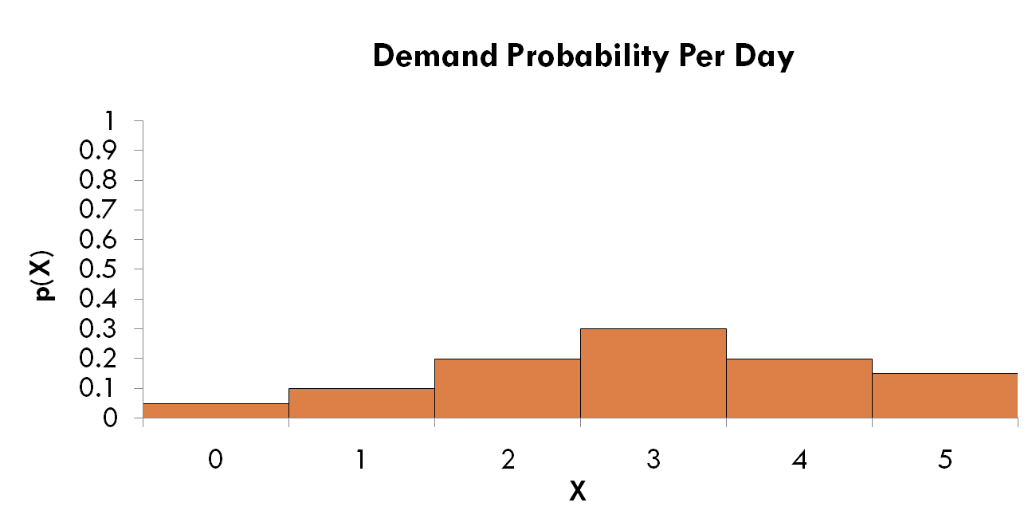
Example 1. HERFY Cake Shop
Step 1: Set up the probability distribution for cake sales.
Using historical data HERFY Shop determined that 5% of the time 0 cakes were demanded, 10% of the time 1 cake was demanded, etc…
Histogram
P(1) = 10%

Slide 10
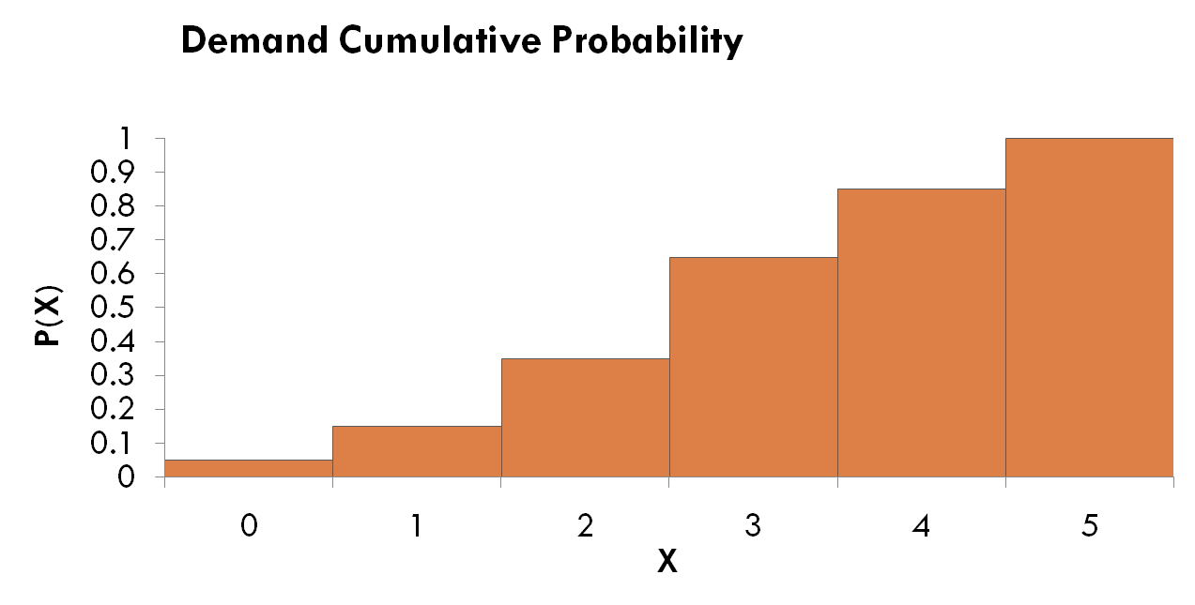
Example 1. HERFY Cake Shop
Step 2: Build a Cumulative Probability Distribution
15% of the time the demand was 0 or 1 cake P(0) = 5% + P(1) = 10%

Slide 11
Example 1. HERFY Cake Shop
Step 3: Establish an interval of random numbers.
Cumulative Probability
Random Number Interval
Demand
Frequency
Probability
Note: 5% of the time 0 cakes are demanded, so the random number interval contains 5% of the numbers between 1 and 100
0
10
0.05
0.05
01 - 05
1
20
0.10
0.15
06 - 15
2
40
0.20
0.35
16 - 35
Must be in correct proportion
3
60
0.30
0.65
36 - 65
4
40
0.20
0.85
66 - 85
5
30
0.15
1.00
86 - 00

Slide 12
Example 1. HERFY Cake Shop
Step 4: Generate random numbers.
52
37
82
69
98
96
33
50
88
90
50
27
45
81
66
74
30
06
63
57
02
94
52
69
33
32
30
48
88
14
02
83
05
34
50
28
68
36
90
62
27
50
18
36
61
21
46
01
14
82
87
88
02
28
49
36
87
21
95
50
24
18
62
32
78
74
82
01
53
74
05
71
06
49
11
13
62
69
85
69
13
82
27
93
74
30
35
94
99
78
56
60
44
57
82
23
64
49
74
76
09
11
10
24
03
32
23
59
95
34
34
51
08
48
66
97
03
96
46
47
03
11
10
67
23
89
62
56
74
54
31
62
37
33
33
82
99
29
27
75
89
78
68
64
62
30
17
12
74
45
11
52
59
37
60
79
21
85
71
48
39
31
35
12
73
41
31
97
78
94
66
74
90
95
29
72
17
55
15
36
80
02
86
94
59
13
25
91
85
87
90
21
90
89
29
40
85
69
68
98
99
81
06
34
35
90
92
94
25
57
34
30
90
01
24
00
92
42
72
28
32
32
73
41
38
73
01
09
64
34
55
84
16
98
49
00
30
23
00
59
09
97
69
98
93
49
51
92
92
16
84
27
64
94
17
84
55
25
71
34
57
50
44
95
64
16
46
54
64
61
23
01
57
17
36
72
85
31
44
30
26
09
49
13
33
89
13
37
58
07
60
77
49
76
95
51
16
14
85
59
85
40
42
52
39
73

Slide 13
Example 1. HERFY Cake Shop
Step 5: Simulate a series of trials.
Using random number table on previous slide, simulated demand for 10 days is:
Tires Interval of
Demanded Random Numbers
0 01 - 05
1 06 - 15
2 16 - 35
3 36 - 65
4 66 - 85
5 86 - 100
2
3
1
Random number: 52 06 50 88 53 30 10 47 99 37
Simulated demand: 3 1 3 5 3 2 1 3 5 3

Slide 14
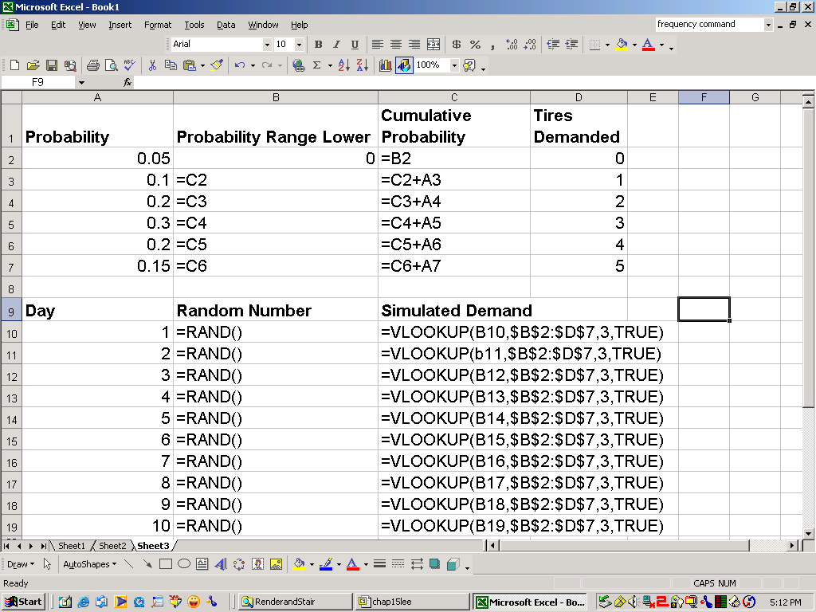
Example 1. HERFY Cake Shop
Create lookup table using cumulative probability
Generate a
random number
and look it up in
the table

Slide 15
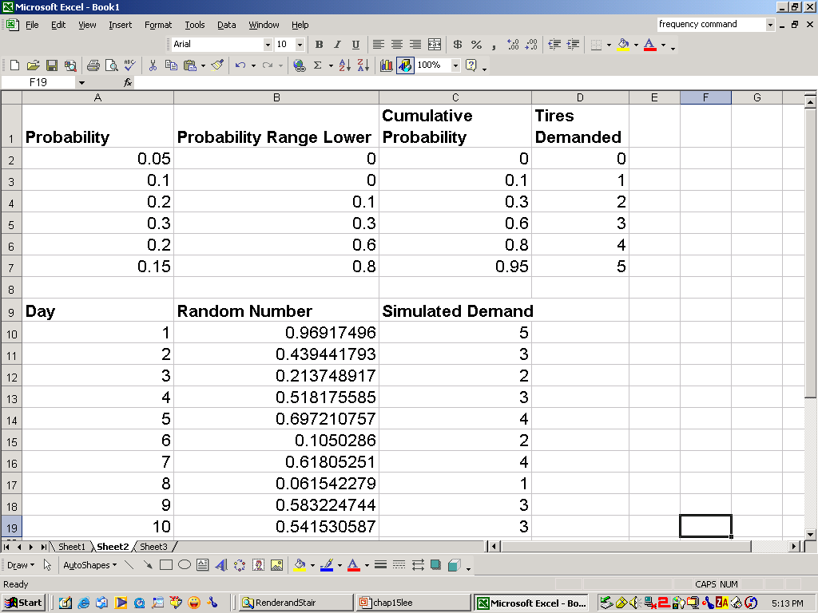
Example 1. HERFY Cake Shop

Slide 16

example montecarlo slides chapter 4 second part
© 2006 by Prentice Hall, Inc.
Upper Saddle River, NJ 07458

Slide 17
Example 2. SEC Power Company
Example inspired from:
To accompany Quantitative Analysis for Management, 9e
by Render/Stair/Hanna

Slide 18
Example 2. SEC Power Company
Example inspired from:
To accompany Quantitative Analysis for Management, 9e
by Render/Stair/Hanna
© 2006 by Prentice Hall, Inc.
Upper Saddle River, NJ 07458
SEC provides power to Riyadh city.
The company is concerned about generator failures because a breakdown costs about 75 SAR per hour versus a 30 SAR per hour salary for repairpersons who work 24 hours a day, seven days a week.
Management wants to evaluate the service maintenance cost, simulated breakdown cost, and total cost.
We can use Monte Carlo simulation to analyze SEC system costs.

Slide 19
Example 2. SEC Power Company
Example inspired from:
To accompany Quantitative Analysis for Management, 9e
by Render/Stair/Hanna
© 2006 by Prentice Hall, Inc.
Upper Saddle River, NJ 07458
Steps 1-3: Determine probability, cumulative probability, and random number interval - BREAKDOWNS.
Time Between Breakdowns (Hrs)
Number of Times Observed
Random Number Interval
Cumulative Probability
Probability
½
5
0.05
0.05
01 - 05
1
6
0.06
0.11
06 - 11
1 ½
16
0.16
0.27
12 - 27
2
33
0.33
0.60
28 - 60
2 ½
21
0.21
0.81
81 - 81
3
19
0.19
1.00
82 - 00
Total 100 1.00

Slide 20
Example 2. SEC Power Company
Example inspired from:
To accompany Quantitative Analysis for Management, 9e
by Render/Stair/Hanna
© 2006 by Prentice Hall, Inc.
Upper Saddle River, NJ 07458
Steps 1-3: Determine probability, cumulative probability, and random number interval - REPAIRS.
Repair Time Required (Hours)
Number of Times Observed
Random Number Interval
Probability
Cumulative Probability
1
28
0.28
0.28
01 - 28
2
52
0.52
0.80
29 - 80
3
20
0.20
1.00
81 - 00

Slide 21
Example 2. SEC Power Company
Example inspired from:
To accompany Quantitative Analysis for Management, 9e
by Render/Stair/Hanna
© 2006 by Prentice Hall, Inc.
Upper Saddle River, NJ 07458
No. of hrs.
Machine is down
Simulation
Trial
Time b/t
Breakdowns
Time of
Breakdown
Time Repair
Can Begin
Time Repair
Ends
Random
Number
Random
Number
Repair Time
1 | 57 | 2 | 2:00 | 2:00 | 7 | 1 | 3:00 | 1
2 | 17 | 1.5 | 3:30 | 3:30 | 60 | 2 | 5:30 | 2
3 | 36 | 2 | 5:30 | 5:30 | 77 | 2 | 7:30 | 2
4 | 72 | 2.5 | 8:00 | 8:00 | 49 | 2 | 10:00 | 2
5 | 85 | 3 | 11:00 | 11:00 | 76 | 2 | 13:00 | 2
: | : | : | : | : | : | : | : | :
14 | 89 | 3 | 4:00 | 6:00 | 42 | 2 | 8:00 | 4
15 | 13 | 1.5 | 5:30 | 8:00 | 52 | 2 | 10:00 | 4.5

